Slide 1
HOSPITALITY PROJECT
-Avala Sai Kiran
-Pannerselvam Rahul Kumar
-Neha Devarashetty
-Shaik.Ameer shareef
-D.Mohan Kali Prasad
-Jampala Hanuman
-Pepakayala Santhosh -Darshan V
-

Slide 2
INTRODUCTION
This project focuses on analysing hospitality booking data to evaluate hotel performance.
Key business metrics such as revenue, bookings, occupancy, and customer behaviour are examined.
The insights from this analysis support data-driven decision-making for hotel management.

Slide 3


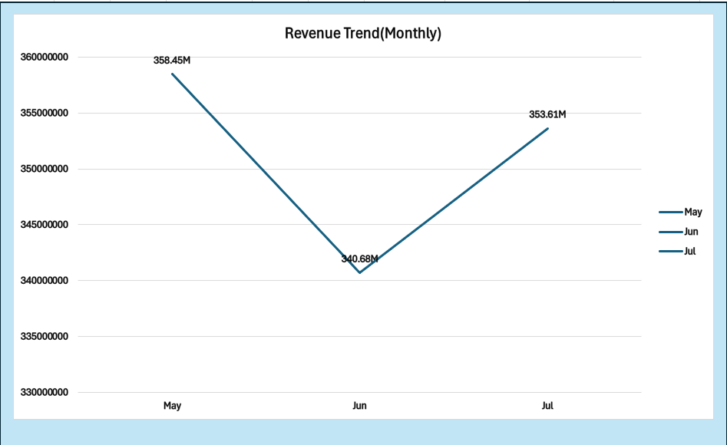

REVENUE TREND BY MONTH(From Excel)
Strong revenue in May
Temporary drop in June
Improvement again in July

Slide 4
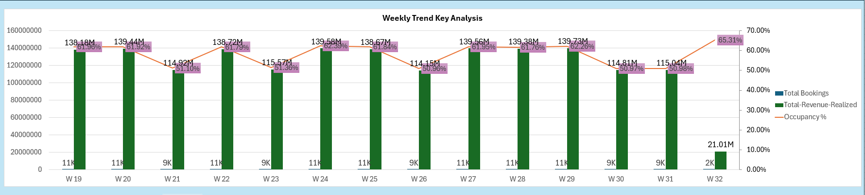
WEEKLY TREND ANALYSIS(From Excel)
Revenue and bookings show small fluctuations week by week.
Mid-weeks perform better, with higher revenue and occupancy.
A slight drop is seen towards the later weeks, indicating variability in demand.

Slide 5
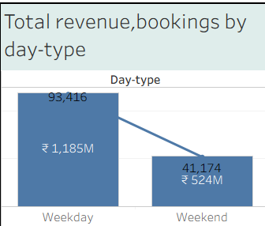
TOTAL REVENUE &BOOKING BY DAY-TYPE(WEEKDAY,WEEKEND)(From Tableau)
Majority of bookings occur on weekdays
Revenue is significantly higher on weekdays than weekends.
Weekends have lower contribution to overall performance.

Slide 6
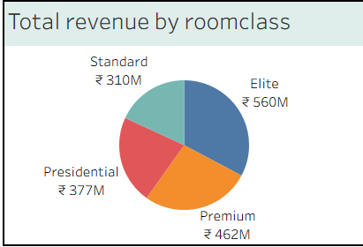
TOTAL REVENUE BY ROOM-CATEGORY(From Tableau)
Elite rooms generate the highest revenue, contributing the largest share.
Premium and Presidential classes also contribute significantly to overall revenue.
Standard rooms contribute the least, indicating lower pricing or demand.

Slide 7
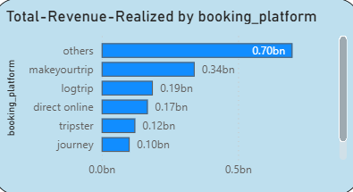
TOTAL REVENUE BY BOOKING_PLATFORM(From PowerBI)
Other platforms contribute the highest revenue, making them the top revenue source.
MakeYourTrip and LogTrip are the next major contributors.
Direct online and smaller platforms generate comparatively lower revenue.

Slide 8
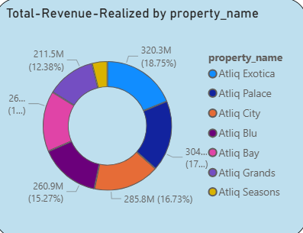
TOTAL REVENUE BY PROPERTY_NAME (From PowerBI)
Atliq Exotica generates the highest revenue among all properties.
Most properties contribute a balanced share to total revenue.
Some properties have lower revenue, showing room for improvement.

Slide 9
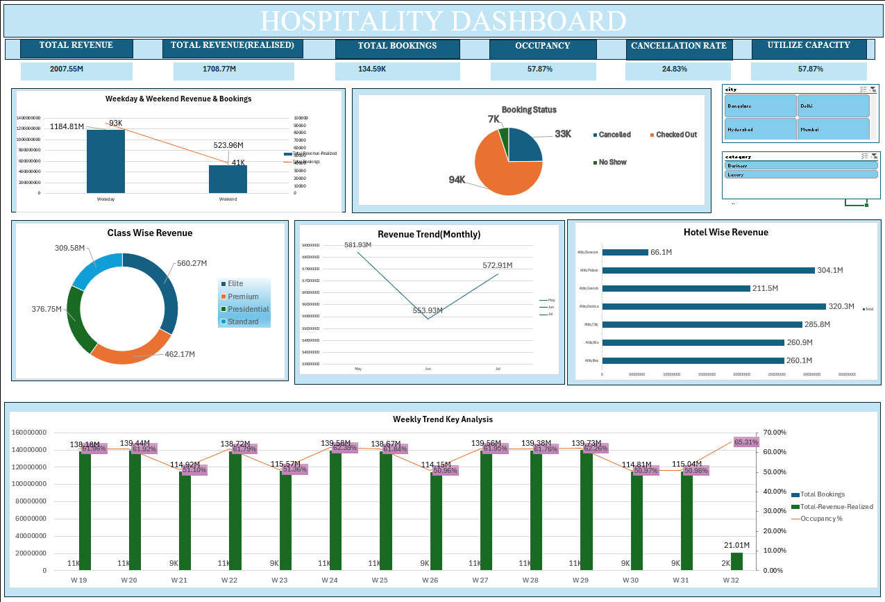
EXCEL DASHBOARD

Slide 10
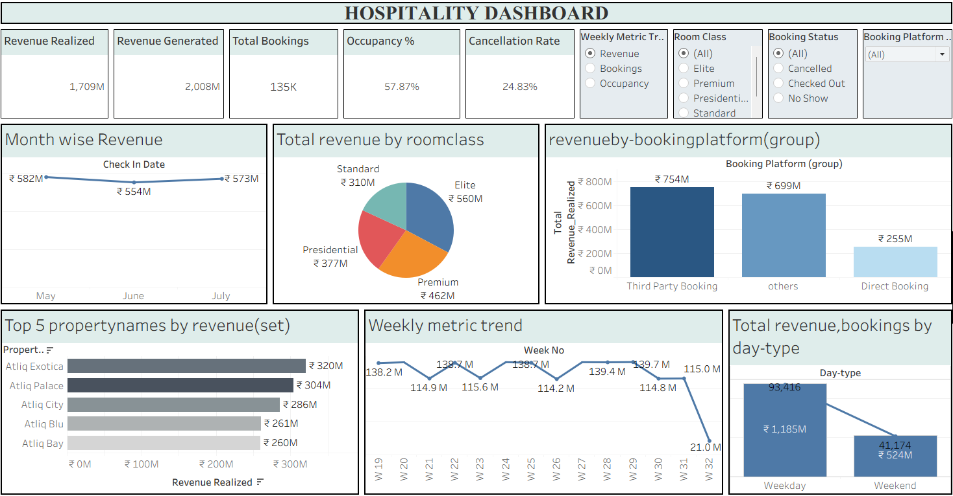
TABLEAU DASHBOARD

Slide 11
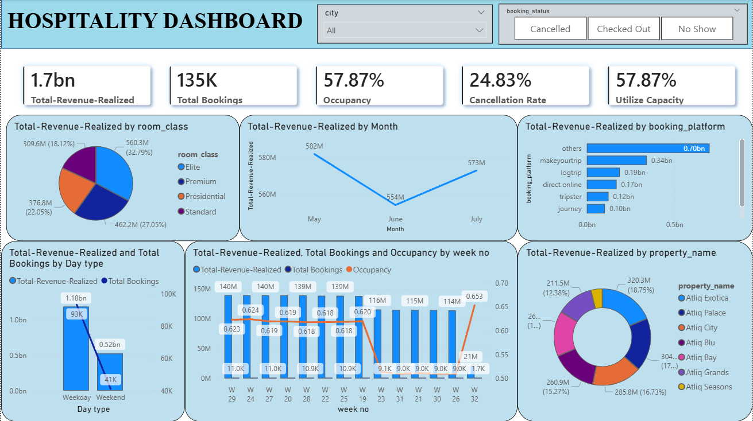
POWERBI DASHBOARD

Slide 12
RECOMMENDATIONS
Boost weekend performance by introducing attractive offers, packages, and dynamic pricing strategies.
Increase revenue through premium room upselling, especially for Elite and Premium categories.
Use demand trends for smarter planning, adjusting pricing and availability based on weekly and monthly insights.
Improve booking reliability by reducing cancellations through timely reminders and flexible policies.

Slide 13
CONCLUSION
This project transforms raw booking data into meaningful insights through interactive dashboards. It highlights important patterns in revenue, occupancy, and customer behaviour. The analysis supports informed decisions on pricing, demand management, and promotions.
Overall, the project demonstrates how data can improve business performance and revenue growth.

